Slide 1

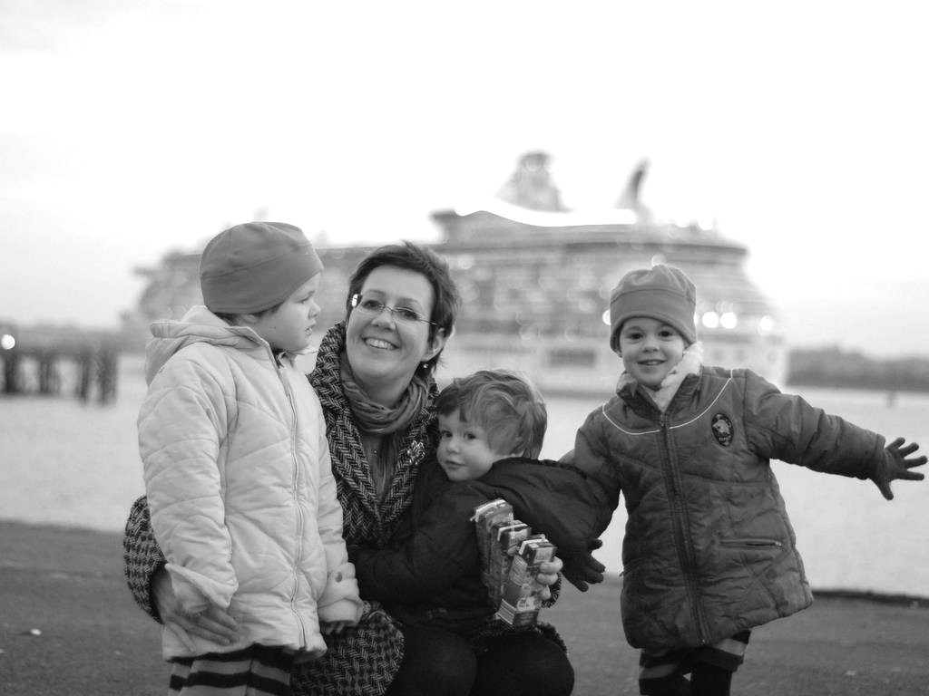
Intention and
Motor Representation
in Joint Action
s.butterfill@warwick.ac.uk

Slide 2
premise:
Social motor cognition enables joint action
question:
Does social motor cognition also play a role in explaining what joint action is? [Yes]
challenge:
How could social motor representation and shared intention harmoniously contribute to joint action?
Notes:
the plan ... outline the two (independent challenges).
motor cognition --- distinct from practical reasoning
social --- representation of the goals of other agents’ actions and perhaps other agents’ tasks
shared intention --- a deeply problematic notion

Slide 3
premise:
Social motor cognition enables joint action
question:
Does social motor cognition also play a role in explaining what joint action is? [Yes]
challenge:
How could social motor representation and shared intention harmoniously contribute to joint action?
Notes:
the plan ... outline the two (independent challenges).
motor cognition --- distinct from practical reasoning
social --- representation of the goals of other agents’ actions and perhaps other agents’ tasks
shared intention --- a deeply problematic notion

Slide 4
premise:
Social motor cognition enables joint action
question:
Does social motor cognition also play a role in explaining what joint action is? [Yes]
challenge:
How could social motor representation and shared intention harmoniously contribute to joint action?
Notes:
the plan ... outline the two (independent challenges).
motor cognition --- distinct from practical reasoning
social --- representation of the goals of other agents’ actions and perhaps other agents’ tasks
joint action --- actually
shared intention --- a deeply problematic notion

Slide 5
premise:
Social motor cognition enables joint action
question:
Does social motor cognition also play a role in explaining what joint action is? [Yes]
challenge:
How could social motor representation and shared intention harmoniously contribute to joint action?
“motor activation during action anticipation depends on the ... relation between the actor and the observer ... Simulation of another person’s action, as reﬂected in the activation of motor cortices, gets stronger the more the other is perceived as an interaction partner.”
--- Kourtis, Sebanz & Knoblich (2010, p. 4)
Notes:
the plan ... outline the two (independent challenges).
motor cognition --- distinct from practical reasoning
social --- representation of the goals of other agents’ actions and perhaps other agents’ tasks
joint action --- actually
shared intention --- a deeply problematic notion

Slide 6
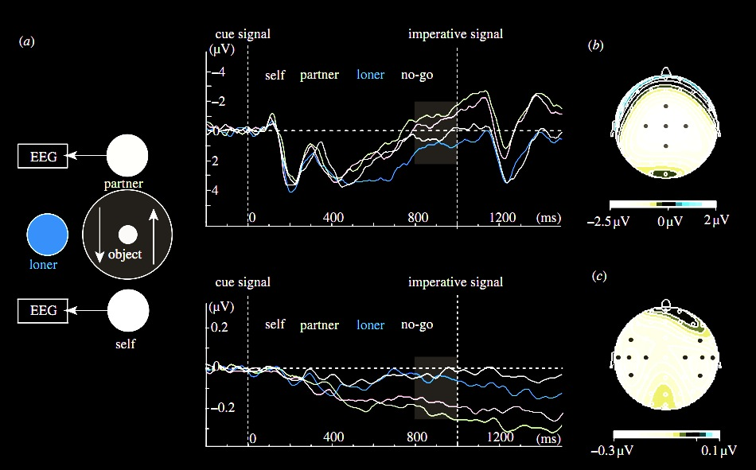
premise:
Social motor cognition enables joint action
Kourtis, Sebanz & Knoblich (2010)
Notes:
Illustration --- motor areas active in selectively anticipating actions of an interaction parnter \citep{kourtis:2010_favoritism}

Slide 7
premise:
Social motor cognition enables joint action
Kourtis, Sebanz & Knoblich (2010)
Notes:
Illustration --- motor areas active in selectively anticipating actions of an interaction parnter \citep{kourtis:2010_favoritism}

Slide 8
premise:
Social motor cognition enables joint action
Kourtis, Sebanz & Knoblich (2010)
Notes:
Illustration --- motor areas active in selectively anticipating actions of an interaction parnter

Slide 9
premise:
Social motor cognition enables joint action
Kourtis, Sebanz & Knoblich (2010)
Notes:
Illustration --- motor areas active in selectively anticipating actions of an interaction parnter

Slide 10
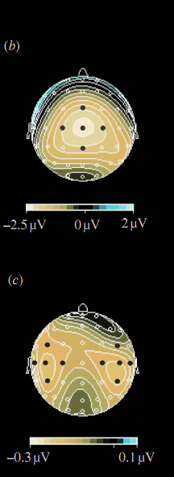
premise:
Social motor cognition enables joint action
Kourtis, Sebanz & Knoblich (2010)
Notes:
Illustration --- motor areas active in selectively anticipating actions of an interaction parnter

Slide 11
premise:
Social motor cognition enables joint action
question:
Does social motor cognition also play a role in explaining what joint action is? [Yes]
challenge:
How could social motor representation and shared intention harmoniously contribute to joint action?
Notes:
the plan ... outline the two (independent challenges).

Slide 12
premise:
Social motor cognition enables joint action
question:
Does social motor cognition also play a role in explaining what joint action is? [Yes]
challenge:
How could social motor representation and shared intention harmoniously contribute to joint action?
Notes:
the plan ... outline the two (independent challenges).

Slide 13
premise:
Social motor cognition enables joint action
question:
Does social motor cognition also play a role in explaining what joint action is? [Yes]
challenge:
How could social motor representation and shared intention harmoniously contribute to joint action?

Slide 14
premise:
Social motor cognition enables joint action
question:
Does social motor cognition also play a role in explaining what joint action is? [Yes]
challenge:
How could social motor representation and shared intention harmoniously contribute to joint action?
Notes:
Where should we start thinking about joint action? Maybe this is very familiar territory, but I want to go slowly here because I’m suspicious that some assumptions get smuggled into discussion right at the start. But, you might say, isn’t there already a perfectly good definition of joint action?

Slide 15
premise:
Social motor cognition enables joint action
question:
Does social motor cognition also play a role in explaining what joint action is? [Yes]
challenge:
How could social motor representation and shared intention harmoniously contribute to joint action?
‘joint action [is] any form of social interaction whereby two or more individuals coordinate their actions in space and time to bring about a change in the environment.’
(Sebanz, Bekkering & Knoblich 2006: 70)
Notes:
Sometimes joint action is introduced by citing what was offered as a ‘working definition’ but now seems to carry a lot of weight.
If this was a fully adequate definition of joint action, there would be no special role for social motor cognition in explaining what joint action is.
Why am I not entirely satisfied with this?

Slide 16
premise:
Social motor cognition enables joint action
question:
Does social motor cognition also play a role in explaining what joint action is? [Yes]
challenge:
How could social motor representation and shared intention harmoniously contribute to joint action?
‘joint action [is] any form of social interaction whereby two or more individuals coordinate their actions in space and time to bring about a change in the environment.’
(Sebanz, Bekkering & Knoblich 2006: 70)
Notes:
what’s that --- seems to be a more complex notion

Slide 17
premise:
Social motor cognition enables joint action
question:
Does social motor cognition also play a role in explaining what joint action is? [Yes]
challenge:
How could social motor representation and shared intention harmoniously contribute to joint action?
‘joint action [is] any form of social interaction whereby two or more individuals coordinate their actions in space and time to bring about a change in the environment.’
(Sebanz, Bekkering & Knoblich 2006: 70)
Notes:
This suggests that individuals are coordinating *in order to* bring about a change ... but

Slide 18
premise:
Social motor cognition enables joint action
question:
Does social motor cognition also play a role in explaining what joint action is? [Yes]
challenge:
How could social motor representation and shared intention harmoniously contribute to joint action?
‘joint action [is] any form of social interaction whereby two or more individuals coordinate their actions in space and time to bring about a change in the environment.’
(Sebanz, Bekkering & Knoblich 2006: 70)
Notes:
The restriction to space and time seems unnecessary, it can’t be long before everyone is having facebook weddings.

Slide 19
premise:
Social motor cognition enables joint action
question:
Does social motor cognition also play a role in explaining what joint action is? [Yes]
challenge:
How could social motor representation and shared intention harmoniously contribute to joint action?
‘joint action [is] any form of social interaction whereby two or more individuals coordinate their actions in space and time to bring about a change in the environment.’
(Sebanz, Bekkering & Knoblich 2006: 70)

Slide 20
premise:
Social motor cognition enables joint action
question:
Does social motor cognition also play a role in explaining what joint action is? [Yes]
challenge:
How could social motor representation and shared intention harmoniously contribute to joint action?
Notes:
If not that definition, where should we start in understanding what joint action is.
Most people don’t actually define joint action but introduce it by examples. Psychologists standard examples include ...

Slide 21
tidying up the toys together
(Behne et al 2005)
cooperatively pulling handles in sequence to make a dog-puppet sing
(Brownell et al 2006)
bouncing a ball on a large trampoline together
(Tomasello & Carpenter 2007)
pretending to row a boat together
Notes:
Two challenges : (1) fit intuitive category; (2) explain the contrast cases

Slide 22
painting a house together
(Bratman 1992)
lifting a heavy sofa together
(Velleman 1997)
preparing a hollandaise sauce together
(Searle 1990)
going to Chicago together
(Kutz 2000)
walking together
(Gilbert 1990)
tidying up the toys together
(Behne et al 2005)
cooperatively pulling handles in sequence to make a dog-puppet sing
(Brownell et al 2006)
bouncing a ball on a large trampoline together
(Tomasello & Carpenter 2007)
pretending to row a boat together
Notes:
These anchor our understanding of what joint action is.
These examples are not supposed to be merely cases of joint action, whatever that is. They are also supposed to be paradigm cases, and they are supposed to be cases reflection on which could provide an intuitive understanding of what joint action is.
So if there is some notion or notions an intuitive understanding of which can be gained by reflection on these examples, then that notion (or those notions) are notions of joint action.
I think we can do slightly better than just citing examples, though.
There are also some useful contrast cases.

Slide 23
Joint
Not joint
Notes:
In introducing joint action philosophers sometimes use contrast cases, pairs of actions which are similar in terms of behaviour and coordination but where one is joint but the other isn’t.

Slide 24
Joint
Not joint
Jack and Sue walk together
Jack and Sue walk alongside each other
(Gilbert 1990)

Slide 25
Joint
Not joint
Jack and Sue walk together
Jack and Sue walk alongside each other
(Gilbert 1990)
We collectively perform a dance by running to a shelter at the same time
We each individually run to a shelter at the same time (in response to a sudden shower).
(Searle 1990, 92)
Notes:
These sorts of contrast case invite the question, How do joint actions differ from individual actions which may occur in parallel? What is the difference between Jack & Sue walking together and their walking side-by-side? Gilbert’s example shows that the difference can’t just be a matter of coordination, because people merely walking alongside each other also need to coordinate their actions in order to avoid colliding with each other. And Searle’s example shows that the difference between joint action and parallel individual action can’t just be that the actions have a common effect because merely parallel actions can have common effects too.

Slide 26
exoticism
Notes:
So how should we explain the contrast cases? How does a joint action involving two or more agents differ from an event comprising the merely parallel actions of those agents?
In answering this most philosophers endorse exoticism.
Exoticism is the thesis that distinctive ingredients are needed to characterise joint action, ingredients which are not needed to characterise ordinary individual action.

Slide 27
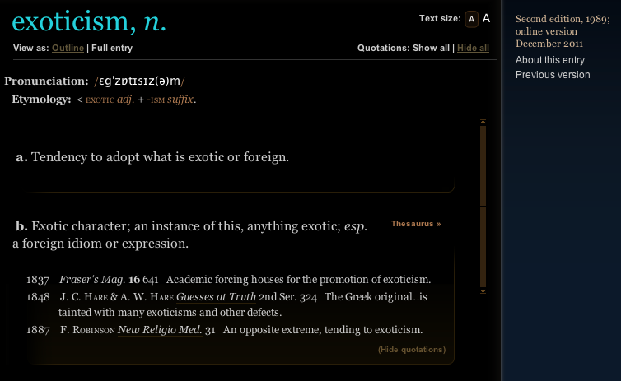
exoticism

Slide 28
shared
intention
(or ’collective’)
Notes:
Exoticism very often takes the form of a belief that shared intention is necessary for joint action.
Shared intention is the exotic ingredient in joint action, the thing not needed for characterising ordinary, individual action but whose presence distinguishes cases of joint action from cases of merely parallel action.

Slide 29
‘I take a collective action to involve a collective [shared] intention.’
(Gilbert 2006, p. 5)
Notes:
so MG says ...

Slide 30
‘I take a collective action to involve a collective [shared] intention.’
(Gilbert 2006, p. 5)
‘The sine qua non of collaborative action is a joint goal [shared intention] and a joint commitment’
(Tomasello 2008, p. 181)

Slide 31
‘I take a collective action to involve a collective [shared] intention.’
(Gilbert 2006, p. 5)
‘The sine qua non of collaborative action is a joint goal [shared intention] and a joint commitment’
(Tomasello 2008, p. 181)
‘the key property of joint action lies in its internal component [...] in the participants’ having a “collective” or “shared” intention.’
(Alonso 2009, pp. 444-5)
‘Shared intentionality is the foundation upon which joint action is built.’
(Carpenter 2009, p. 381)

Slide 32
‘I take a collective action to involve a collective [shared] intention.’
(Gilbert 2006, p. 5)
‘The sine qua non of collaborative action is a joint goal [shared intention] and a joint commitment’
(Tomasello 2008, p. 181)
‘the key property of joint action lies in its internal component [...] in the participants’ having a “collective” or “shared” intention.’
(Alonso 2009, pp. 444-5)
‘Shared intentionality is the foundation upon which joint action is built.’
(Carpenter 2009, p. 381)
Notes:
So we’re interested in shared intention because it is supposed to explain the contrast cases --- to distinguish merely parallel cases from genuinely joint actions.
The idea is that a joint action is an action that bears some appropriate relation to a shared intention.
If this definition is adequate, then clearly there is no need to appeal to social motor cognition in explaining joint action.
But what is shared intention?
The notion of shared intention is problematic: on most accounts, a shared intention is neither shared nor an intention. It’s an intriguing, romantic-sounding term but what does it pick out?
Unfortunately there seem to be as many different accounts of shared intention as there are philosophers who have discussed it (and yes I am working on an account of shared intention of my very own, of course ---- and I’ll come to that later).
---
Structure of Objections:
What is wrong with this widely held view?
I think there are three reasons for resisting it.
1. One is simply that the notion of shared intention is problematic: there seem to be as many different accounts of shared intention as there are philosophers who have discussed it (and yes I am working on an account of shared intention of my very own, of course).
2. A second is that the parallel move in the case of individual action is at least questionable
3. Third is that we should avoid exoticism generally ...

Slide 33
shared intention
<---->
joint action
intention
<---->
action
Notes:
Despite the disagreement on details, I think one thing almost everyone agrees about is this: shared intention is to joint action at least approximately what ordinary individual intention is to ordinary, individual action.
This doesn’t massively help us. The question was, What is joint action? The answer was, something that stands in an appropriate relation to a shared intention. Then we ask what a shared intention is. And the answer is, it’s something that stands in an appropriate relation to a joint action. I don’t think all circles are bad, but this circle doesn’t provide much insight into what joint action is.
In fact this parallel provides a reason for rejecting the idea that joint actions could be defined in terms of shared intention.
The reason is simply that it is similarly a mistake to define action in terms of intention.
Let me explain ....
Intention is not simply a desire, or a strongest desire.
Creatures can engage in goal-directed actions without intentions (merely have beliefs and desires).
We can act in this way too, and maybe we do much of the time.
Intentions are only really necessary where there is planning to ensure compatibility in pursuit of multiple objectives.

Slide 34
shared intention
<---->
joint action
intention
<---->
action
Notes:
Despite the disagreement on details, I think one thing almost everyone agrees about is this: shared intention is to joint action at least approximately what ordinary individual intention is to ordinary, individual action.
This doesn’t massively help us. The question was, What is joint action? The answer was, something that stands in an appropriate relation to a shared intention. Then we ask what a shared intention is. And the answer is, it’s something that stands in an appropriate relation to a joint action. I don’t think all circles are bad, but this circle doesn’t provide much insight into what joint action is.
In fact this parallel provides a reason for rejecting the idea that joint actions could be defined in terms of shared intention.
The reason is simply that it is similarly a mistake to define action in terms of intention.
Let me explain ....
Intention is not simply a desire, or a strongest desire.
Creatures can engage in goal-directed actions without intentions (merely have beliefs and desires).
We can act in this way too, and maybe we do much of the time.
Intentions are only really necessary where there is planning to ensure compatibility in pursuit of multiple objectives.

Slide 35
shared intention
<---->
joint action
intention
<---->
action
Notes:
Despite the disagreement on details, I think one thing almost everyone agrees about is this: shared intention is to joint action at least approximately what ordinary individual intention is to ordinary, individual action.
This doesn’t massively help us. The question was, What is joint action? The answer was, something that stands in an appropriate relation to a shared intention. Then we ask what a shared intention is. And the answer is, it’s something that stands in an appropriate relation to a joint action. I don’t think all circles are bad, but this circle doesn’t provide much insight into what joint action is.
In fact this parallel provides a reason for rejecting the idea that joint actions could be defined in terms of shared intention.
The reason is simply that it is similarly a mistake to define action in terms of intention.
Let me explain ....
Intention is not simply a desire, or a strongest desire.
Creatures can engage in goal-directed actions without intentions (merely have beliefs and desires).
We can act in this way too, and maybe we do much of the time.
Intentions are only really necessary where there is planning to ensure compatibility in pursuit of multiple objectives.

Slide 36
shared intention
<---->
joint action
intention
<---->
action
Notes:
Let’s look at the individual case ...

Slide 37
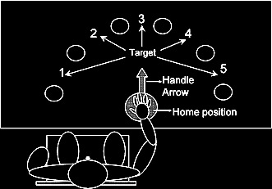
(Zhang and Rosenbaum 2007)
Notes:
This is an example where you don’t need intentions, although in an interesting sense there is planning

Slide 38
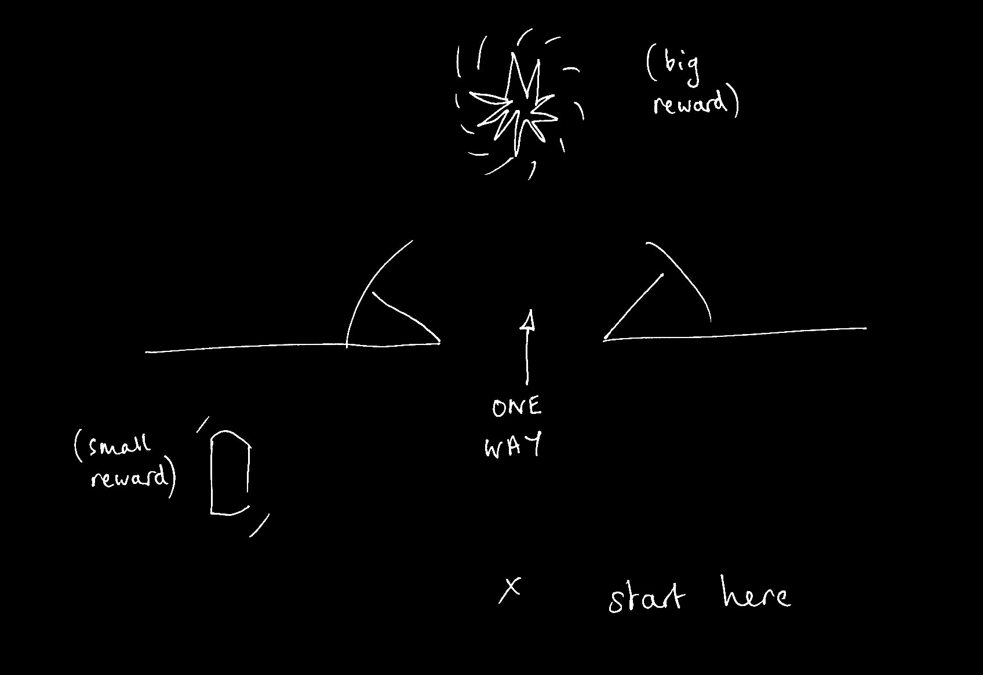
Notes:
And this is a case where intentions are really needed --- can’t act on strongest desire (for the big reward) if want to maximise rewards by collecting the small and the large reward.
Intentions are for planning [*not sure exactly how to work this in : the point is that not all actions involve intention]

Slide 39
Do all actions involve intentions? No.
Notes:
Does every action involve an intention?
This is a tricky question because in some cases the term ‘intention’ is used just for a strongest desire.
But if we don’t use ‘intention’ in that way, if we suppose that a strongest desire is not necessarily an intention, then there is reason to suppose that some actions do not involve any intentions.
Let me explain.
Consider an agent who has beliefs and desires and no other kind of propositional attitude. When the agent faces a choice, its beliefs determine what it thinks the outcomes of each choice will be and how probable each of these outcomes will be given the choices it makes. And its desires determine how strongly it prefers one outcome over another. The agent then acts by selecting an option that is not less likely than any other option to realised a preferred outcome.
This agent acts and her actions are purposive but her actions are driven entirely by beliefs and desires, not by intentions at all.
It is striking that two philosophers with the most detailed, rigorous theories about intention allow for the possibility of actions which are purposive and driven by beliefs and desire but not intentions, Velleman and Bratman.
On either theory, it is reasonable to suppose that many of our own everyday actions do not involve intention.
I am hungry, I have an overwhelming desire for a sandwich and I believe that there is one in your hand.
When you offer me the sandwich, I take it.
Not because I have any intention, but simply because this is what my beliefs and desires dispose me to do.
There is simply no need, in this sort of case, to suppose that I am acting on any intention at all.
OK, I know that there are people here who have different views, who have developed Searle’s idea that there are intentions in action.
I am sceptical that there is any need for intentions in action

Slide 40
1. All actions are intentional.
2. An agent who does something intentionally is acting on an intention.
Notes:
And it seems to me that if we reject these claims then we should also reject the claim that all purposive actions involve intentions.

Slide 41
1. All actions are intentional.
2. An agent who does something intentionally is acting on an intention.
Notes:
And it seems to me that if we reject these claims then we should also reject the claim that all purposive actions involve intentions.

Slide 42
1. All actions are intentional.
2. An agent who does something intentionally is acting on an intention.
Notes:
And it seems to me that if we reject these claims then we should also reject the claim that all purposive actions involve intentions.

Slide 43
Do all actions involve intentions? No. Maybe not.
Notes:
OK, so maybe we will disagree about this.
But look, suppose I am right.
On my view---like on Bratman’s or Velleman’s---intentions are essential where you need to plan multiple actions (***illustration with putting ball in bucket) or where you need a sophisticated form of self-understanding. They aren’t essential merely for acting, for taking a sandwich or for running for a bus.
If this is right, not all ordinary, individual actions involve intention.
But then, if shared intentions are supposed to stand to joint actions as ordinary, individual intentions stand to ordinary, individual actions, then it surely can’t be the case that all joint actions involve shared intentions.
But if there are joint actions without shared intention, then we can’t appeal to shared intention to explain how joint actions differ from merely parallel actions.
So the second reason for rejecting the view that all joint actions involve shared intentions is just the thought that it seems implausible given that not all actions involve intentions.

Slide 44
shared intention
<---->
joint action
intention
<---->
action
Notes:
So the moral of all that was:
1. In the individual case, not all actions involve intention
2. So it would be a mistake to define action in terms of intention (e.g. an action is an event that stands in a certain relation to an intention)
3. And not defining action in terms of intention has a benefit, for it enables us without circularity to explain intentions in terms of actions (their role is in planning actions).
4. So if we think there is a parallel between the individual and joint cases --- and I suppose everyone *does* think this --- we should also be sceptical about whether joint action can be defined in terms of shared intention

Slide 45
exoticism
Notes:
The third reason for rejecting the claim that all joint actions involve shared intention is what will in effect occupy me in the rest of the talk.
The claim that all joint actions involve shared intention is a form of exoticism.
An in philosophy it is better to avoid exoticism if we can ... that is, it is better to have a theory which doesn’t require exotic ingredients.
So if I can show that there is a way of characterising joint action without appeal to exotic ingredients, I will have given a reason for supposing that no such ingredients are necessary.

Slide 46
‘The key question in the philosophy of collective action is simply ... under what conditions are two or more people doing something together?’
(Gilbert 2010: 67)
Notes:
Exoticism about joint action is so widely assumed that it is often implicit ...

Slide 47
‘The key question in the philosophy of collective action is simply ... under what conditions are two or more people doing something together?’
(Gilbert 2010: 67)
Notes:
the assumption that there is a philosophy of joint (‘collective’) action is the assumption of exoticism.
But maybe this is like the assumption that there is a philosophy of feline action ...
Why think that there are two separate questions:
- under what conditions is a single agent doing something?
- under what conditions are two or more agents doing something together?

Slide 48
Joint action:
an action with two or more agents (Ludwig 2007)
Notes:
Ludwig's picture is really beautiful:
1. joint actions are actions with multiple agents
2. shared intentions are intentions on the part of each of us that we perform a joint action.
The joint-ness is not in the intention but in the action, and this greatly simplifies the account of shared intention that we need.
This is a beautiful illustration of anti-exoticism about joint action.
The view characterises joint action as merely action.
On this view there really is no such thing as the `philosophy of collective action'.
But unfortunately this is wrong ...
In what follows I want, first, to explain why it is wrong.
I then want to show how taking seriously the possibility that some actions involve social motor representations would enable us to fix the view.
So the idea will be that we can avoid exoticism about joint action but only by recognising that motor representation plays a role in explaining what joint action is.

Slide 49
Joint action:
an action with two or more agents (Ludwig 2007)

Slide 50
Joint action:
an action with two or more agents (Ludwig 2007)
‘our primitive actions, the ones we do not by doing something else, ... these are all the actions there are.’ (Davidson 1971, p. 59).

Slide 51
Joint action:
an action with two or more agents (Ludwig 2007)
‘our primitive actions, the ones we do not by doing something else, ... these are all the actions there are.’ (Davidson 1971, p. 59).
move fingers
unlock door
turn key

Slide 52
Joint action:
an action with two or more agents (Ludwig 2007)
‘our primitive actions, the ones we do not by doing something else, ... these are all the actions there are.’ (Davidson 1971, p. 59).
move fingers
unlock door
turn key

Slide 53
Joint action:
an action with two or more agents (Ludwig 2007)
‘our primitive actions, the ones we do not by doing something else, ... these are all the actions there are.’ (Davidson 1971, p. 59).
move fingers
unlock door
turn key

Slide 54
Joint action:
an action with two or more agents (Ludwig 2007)
‘our primitive actions, the ones we do not by doing something else, ... these are all the actions there are.’ (Davidson 1971, p. 59).
tidying up the toys together
(Behne et al 2005)
cooperatively pulling handles in sequence to make a dog-puppet sing
(Brownell et al 2006)
bouncing a ball on a large trampoline together
(Tomasello & Carpenter 2007)
pretending to row a boat together
move fingers
unlock door
turn key

Slide 55
Joint action:
an action with two or more agents (Ludwig 2007)
‘our primitive actions, the ones we do not by doing something else, ... these are all the actions there are.’ (Davidson 1971, p. 59).
tidying up the toys together
(Behne et al 2005)
cooperatively pulling handles in sequence to make a dog-puppet sing
(Brownell et al 2006)
bouncing a ball on a large trampoline together
(Tomasello & Carpenter 2007)
pretending to row a boat together
move fingers
unlock door
turn key

Slide 56
Joint action:
an action with two or more agents (Ludwig 2007)
tidying up the toys together
(Behne et al 2005)
cooperatively pulling handles in sequence to make a dog-puppet sing
(Brownell et al 2006)
bouncing a ball on a large trampoline together
(Tomasello & Carpenter 2007)
pretending to row a boat together
my pulling
dog’s singing
your pulling
We make the dog sing

Slide 57
Joint action:
an action with two or more agents (Ludwig 2007)
tidying up the toys together
(Behne et al 2005)
cooperatively pulling handles in sequence to make a dog-puppet sing
(Brownell et al 2006)
bouncing a ball on a large trampoline together
(Tomasello & Carpenter 2007)
pretending to row a boat together
my pulling
dog’s singing
your pulling
We make the dog sing

Slide 58
1
Joint action:
an action with two or more agents (Ludwig 2007)
Bodily movements ‘are all the actions there are’ (Davidson 1971, p. 59)
In supposedly paradigm cases of joint action, there are no bodily movements with more than one agent.
Therefore:
Supposedly paradigm cases are not joint actions.
tidying up the toys together
(Behne et al 2005)
cooperatively pulling handles in sequence to make a dog-puppet sing
(Brownell et al 2006)
bouncing a ball on a large trampoline together
(Tomasello & Carpenter 2007)
pretending to row a boat together
2
3
4

Slide 59
1
too narrow
Joint action:
an action with two or more agents (Ludwig 2007)
Bodily movements ‘are all the actions there are’ (Davidson 1971, p. 59)
In supposedly paradigm cases of joint action, there are no bodily movements with more than one agent.
Therefore:
Supposedly paradigm cases are not joint actions.
tidying up the toys together
(Behne et al 2005)
cooperatively pulling handles in sequence to make a dog-puppet sing
(Brownell et al 2006)
bouncing a ball on a large trampoline together
(Tomasello & Carpenter 2007)
pretending to row a boat together
2
3
4

Slide 60
?
1
too narrow
Joint action:
an action with two or more agents (Ludwig 2007)
Bodily movements ‘are all the actions there are’ (Davidson 1971, p. 59)
In supposedly paradigm cases of joint action, there are no bodily movements with more than one agent.
Therefore:
Supposedly paradigm cases are not joint actions.
tidying up the toys together
(Behne et al 2005)
cooperatively pulling handles in sequence to make a dog-puppet sing
(Brownell et al 2006)
bouncing a ball on a large trampoline together
(Tomasello & Carpenter 2007)
pretending to row a boat together
2
3
4

Slide 61
?
1
too narrow
Joint action:
an action with two or more agents (Ludwig 2007)
Bodily movements ‘are all the actions there are’ (Davidson 1971, p. 59)
In supposedly paradigm cases of joint action, there are no bodily movements with more than one agent.
Therefore:
Supposedly paradigm cases are not joint actions.
tidying up the toys together
(Behne et al 2005)
cooperatively pulling handles in sequence to make a dog-puppet sing
(Brownell et al 2006)
bouncing a ball on a large trampoline together
(Tomasello & Carpenter 2007)
pretending to row a boat together
2
3
4
Notes:
we could reject this ... but I want to pursue a different approach

Slide 62
1
too narrow
Joint action:
an action with two or more agents (Ludwig 2007)
Bodily movements ‘are all the actions there are’ (Davidson 1971, p. 59)
In supposedly paradigm cases of joint action, there are no bodily movements with more than one agent.
Therefore:
Supposedly paradigm cases are not joint actions.
tidying up the toys together
(Behne et al 2005)
cooperatively pulling handles in sequence to make a dog-puppet sing
(Brownell et al 2006)
bouncing a ball on a large trampoline together
(Tomasello & Carpenter 2007)
pretending to row a boat together
2
3
4
Notes:
we could reject this ... but I want to pursue a different approach

Slide 63
Joint action:
an action with two or more agents (Ludwig 2007)

Slide 64
Joint action:
an action event with two or more agents (Ludwig 2007)

Slide 65
Grounding
events D₁, ... D_{n} ground E, if:
D₁, ... D_{n} and E occur;
D₁, ... D_{n} are each (perhaps improper) parts of E; and
every event that is a proper part of E but does not overlap D₁,...D_{n} is caused by some or all of D₁, ... D_{n}.
Agency
For an individual to be among the agents of an event is for there to be actions a₁, ... a_{n} which ground this event where the individual is an agent of one or more of these actions.
(Adapted from Pietroski 1998)

Slide 66
Joint action:
an action event with two or more agents (Ludwig 2007)

Slide 67
Joint action:
an action event with two or more agents (Ludwig 2007)
tidying up the toys together
(Behne et al 2005)
cooperatively pulling handles in sequence to make a dog-puppet sing
(Brownell et al 2006)
bouncing a ball on a large trampoline together
(Tomasello & Carpenter 2007)
pretending to row a boat together
my pulling
dog’s singing
your pulling
We make the dog sing

Slide 68
Joint action:
an action event with two or more agents (Ludwig 2007)
tidying up the toys together
(Behne et al 2005)
cooperatively pulling handles in sequence to make a dog-puppet sing
(Brownell et al 2006)
bouncing a ball on a large trampoline together
(Tomasello & Carpenter 2007)
pretending to row a boat together

Slide 69

Joint action:
an action event with two or more agents (Ludwig 2007)

Slide 70
Joint action:
an action event with two or more agents (Ludwig 2007)
Ant 1’s stinging
The fly’s death
Ant 2’s stinging
The killing of the fly

Slide 71
too broad
Joint action:
an action event with two or more agents (Ludwig 2007)
Ant 1’s stinging
The fly’s death
Ant 2’s stinging
The killing of the fly

Slide 72
too broad
Joint action:
an action event with two or more agents (Ludwig 2007)
tidying up the toys together
(Behne et al 2005)
cooperatively pulling handles in sequence to make a dog-puppet sing
(Brownell et al 2006)
bouncing a ball on a large trampoline together
(Tomasello & Carpenter 2007)
pretending to row a boat together
Ant 1’s stinging
The fly’s death
Ant 2’s stinging
The killing of the fly

Slide 73
Goal-directed joint action: an event with two or more agents which, taken as a whole, is directed to a goal.
tidying up the toys together
(Behne et al 2005)
cooperatively pulling handles in sequence to make a dog-puppet sing
(Brownell et al 2006)
bouncing a ball on a large trampoline together
(Tomasello & Carpenter 2007)
pretending to row a boat together
Ant 1’s stinging
The fly’s death
Ant 2’s stinging
The killing of the fly

Slide 74
Goal-directed joint action: an event with two or more agents which, taken as a whole, is directed to a goal.
tidying up the toys together
(Behne et al 2005)
cooperatively pulling handles in sequence to make a dog-puppet sing
(Brownell et al 2006)
bouncing a ball on a large trampoline together
(Tomasello & Carpenter 2007)
pretending to row a boat together
cooperatively pulling handles in sequence to make a dog-puppet sing
(Brownell et al 2006)
my pulling
dog’s singing
your pulling
We make the dog sing

Slide 75
Goal-directed joint action: an event with two or more agents which, taken as a whole, is directed to a goal.
out
out
act
out
act
out

Slide 76
Goal-directed joint action: an event with two or more agents which, taken as a whole, is directed to a goal.
out
out
act
represents
coordinates
out
act
shared intention
out

Slide 77
Goal-directed joint action: an event with two or more agents which, taken as a whole, is directed to a goal.
???
out
out
act
represents
coordinates
out
act
shared intention
out

Slide 78
Detour
Goals are not intentions

Slide 79
What is the relation between an action and the goal (or goals) to which it is directed?
out
out
act
out
out

Slide 80
What is the relation between an action and the goal (or goals) to which it is directed?
out
out
act
out
out

Slide 81
What is the relation between an action and the goal (or goals) to which it is directed?
out
out
act
out
intention or other goal-state
out

Slide 82
What is the relation between an action and the goal (or goals) to which it is directed?
teleological function
out
out
act
out
intention or other goal-state
out

Slide 83
(i) in the past, actions of this type have caused outcomes of this type; (ii) this action happens now in part because (i).
What is the relation between an action and the goal (or goals) to which it is directed?
teleological function
out
out
act
out
intention or other goal-state
out

Slide 84
(i) in the past, actions of this type have caused outcomes of this type; (ii) this action happens now in part because (i).
What is the relation between an action and the goal (or goals) to which it is directed?
teleological function
out
out
act
out
intention or other goal-state
It is possible to represent goal-directed actions without representing intentions.
out

Slide 85
End Detour

Slide 86
Goal-directed joint action: an event with two or more agents which, taken as a whole, is directed to a goal.
???
out
out
act
represents
coordinates
out
act
shared intention
out

Slide 87
Goal-directed joint action: an event with two or more agents which, taken as a whole, is directed to a goal.
G is a distributive goal: it is an outcome to which each agent’s activities are individually directed and it is possible that: all agents succeed relative to this outcome.

Slide 88
Goal-directed joint action: an event with two or more agents which, taken as a whole, is directed to a goal.
G is a distributive goal: it is an outcome to which each agent’s activities are individually directed and it is possible that: all agents succeed relative to this outcome.
G is a collective goal
(a) it is a distributive goal;
(b) the agents’ activities are coordinated; and
(c) coordination of this type would normally facilitate occurrences of outcomes of this type.

Slide 89
Goal-directed joint action: an event with two or more agents which, taken as a whole, is directed to a goal.
G is a distributive goal: it is an outcome to which each agent’s activities are individually directed and it is possible that: all agents succeed relative to this outcome.
G is a collective goal
(a) it is a distributive goal;
(b) the agents’ activities are coordinated; and
(c) coordination of this type would normally facilitate occurrences of outcomes of this type.

Slide 90
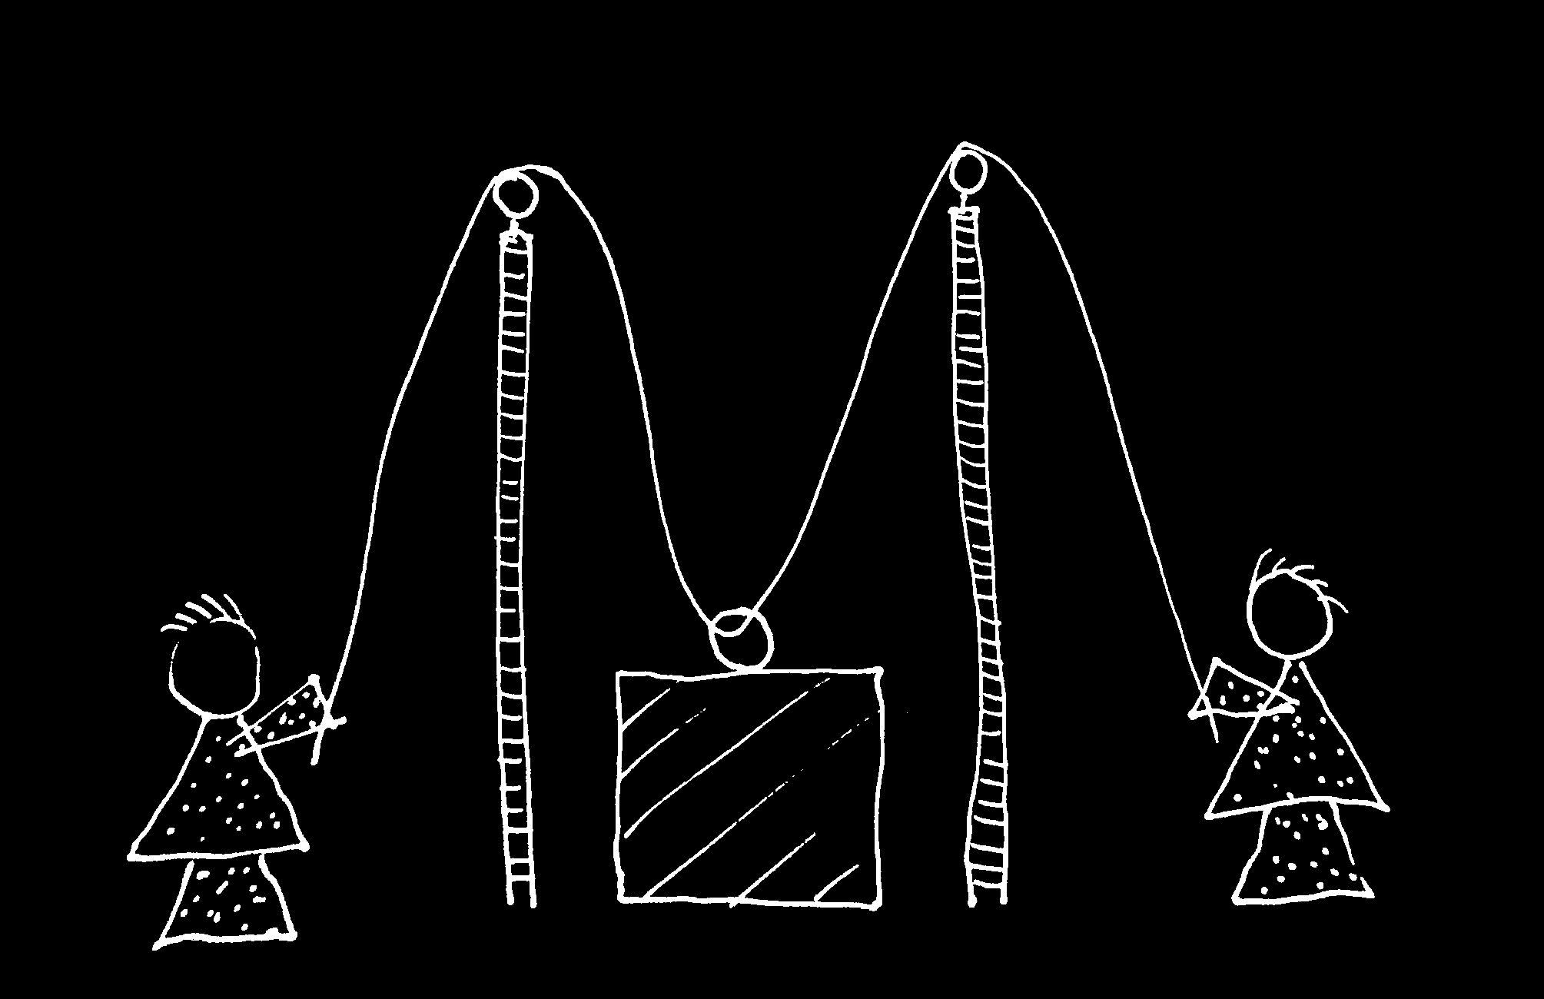

Slide 92
sting
sting
sting
sting
sting
death of fly
sting
sting
sting

Slide 93
Goal-directed joint action: an event with two or more agents which, taken as a whole, is directed to a goal.
G is a distributive goal: it is an outcome to which each agent’s activities are individually directed and it is possible that: all agents succeed relative to this outcome.
G is a collective goal
(a) it is a distributive goal;
(b) the agents’ activities are coordinated; and
(c) coordination of this type would normally facilitate occurrences of outcomes of this type.

Slide 94
Goal-directed joint action: an event with two or more agents which, taken as a whole, is directed to a goal.
G is a distributive goal: it is an outcome to which each agent’s activities are individually directed and it is possible that: all agents succeed relative to this outcome.
G is a shared goal
G is a collective goal
(a) it is a distributive goal;
(b) the agents’ activities are coordinated; and
(c) coordination of this type would normally facilitate occurrences of outcomes of this type.
Each agent expects each of the other agents to perform activities directed to the goal.
Each agent expects the goal to occur as a common effect of all their goal-directed actions.

Slide 95
Joint action:
an action event with two or more agents (Ludwig 2007)

Slide 96
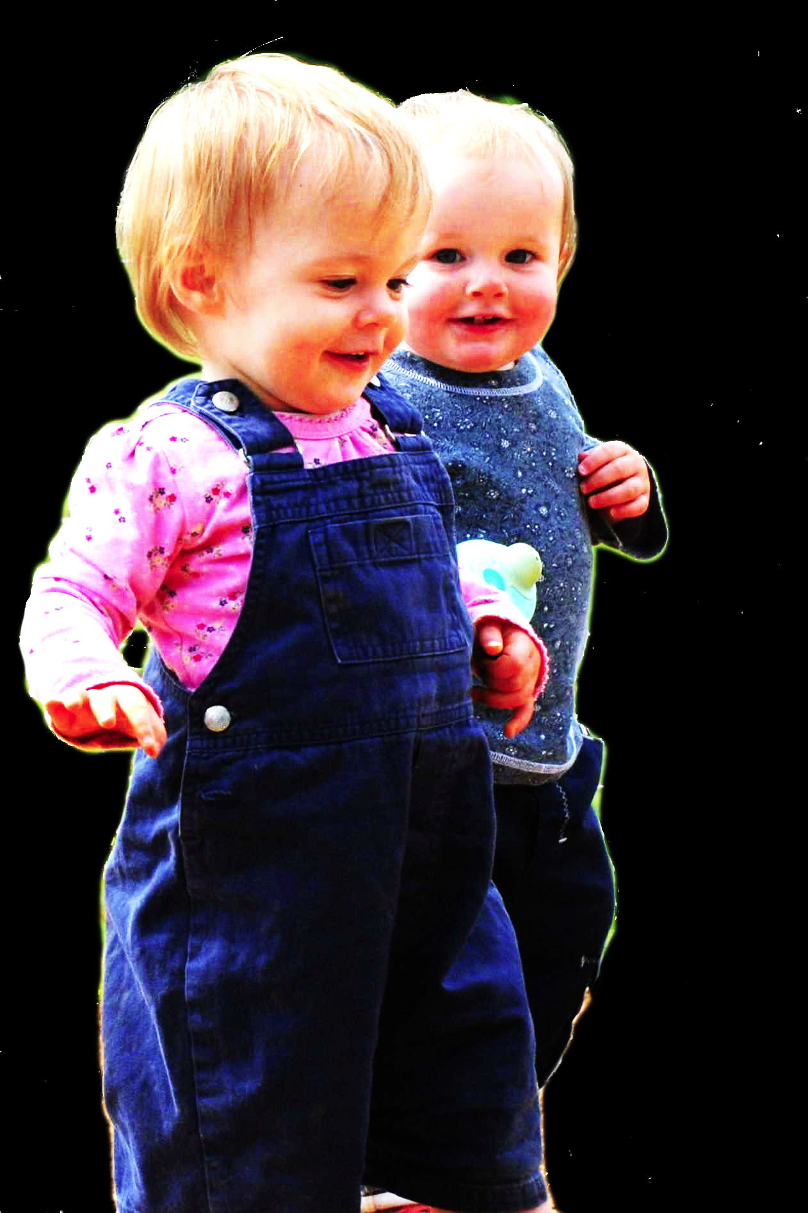
challenge
Explain the emergence, in evolution or development, of sophisticated forms of social cognition.
conjecture
The existence of abilities to engage in joint action partially explains how sophisticated forms of social cognition emerge in evolution or development (or both)
question
Given the conjecture, what could joint action be?

Slide 97
Goal-directed joint action: an event with two or more agents which, taken as a whole, is directed to a goal.
G is a distributive goal: it is an outcome to which each agent’s activities are individually directed and it is possible that: all agents succeed relative to this outcome.
G is a shared goal
G is a collective goal
(a) it is a distributive goal;
(b) the agents’ activities are coordinated; and
(c) coordination of this type would normally facilitate occurrences of outcomes of this type.
Each agent expects each of the other agents to perform activities directed to the goal.
Each agent expects the goal to occur as a common effect of all their goal-directed actions.

Slide 98


Slide 99

joint action &
knowing
others’
minds
Notes:
This is an overview of the project and its aims

Slide 100
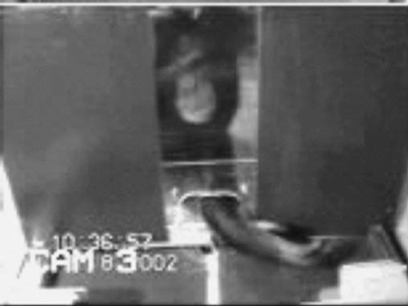

failed reach
point
source: Hare & Tomasello (2004)
Notes:
this illustrates problem of identifying particular goals of action

Slide 101
The problem of opaque means

Slide 102
The problem of false belief

Slide 103
your-goal-is-my-goal

Slide 104
your-goal-is-my-goal
1. We are about to engage in some joint action* or other
2. I am not about to change my goal.
Therefore:
3. Your actions also will be directed to this goal.
[*in at least the minimal sense associated with distributive goals]

Slide 105
failed reach
point
source: Hare & Tomasello (2004)

Slide 106
failed reach
point
source: Hare & Tomasello (2004)
“to understand pointing, the subject needs to understand more than the individual goal-directed behaviour. She needs to understand that ... the other attempts to communicate to her ... and ... the communicative intention behind the gesture”
(Moll & Tomsello 2007)

Slide 107
failed reach
point
source: Hare & Tomasello (2004)
“to understand pointing, the subject needs to understand more than the individual goal-directed behaviour. She needs to understand that ... the other attempts to communicate to her ... and ... the communicative intention behind the gesture”
(Moll & Tomsello 2007)

Slide 108
Csibra’s ‘two stances’:
Teleological and referential action interpretation ‘rely on different kinds of action understanding’
These are initially two distinct ‘action interpretation systems’ and they come together later in development
Csibra (2003, p. 456)

Slide 109
minimal theory of mind cognition
joint action (ability to share goals)
understanding communicative intent
other stuff
communication by language
other stuff
full-blown theory of mind cognition

Slide 111
Joint action:
an event with two or more agents (Ludwig 2007)
Goal-directed joint action:
a joint action which, taken as a whole, is directed to a goal
Nora’s shooting
Fred’s death
Olive’s shooting
Fred’s killing

Slide 112
What is the relation between an action and the goal (or goals) to which it is directed?

Slide 113
What is the relation between an action and the goal (or goals) to which it is directed?

Slide 114
What is the relation between an action and the goal (or goals) to which it is directed?
out
out
act
out
out

Slide 115
What is the relation between an action and the goal (or goals) to which it is directed?
out
out
act
(goal)
out
out

Slide 116
What is the relation between an action and the goal (or goals) to which it is directed?
out
out
act
represents
coordinates
(goal)
out
intention or other goal-state
out

Slide 117
What is the relation between an action and the goal (or goals) to which it is directed?
teleological function
out
out
act
represents
coordinates
out
intention or other goal-state
out

Slide 118
What is the relation between an action and the goal (or goals) to which it is directed?
teleological function
out
out
act
represents
coordinates
out
intention or other goal-state
It is possible to represent goal-directed actions without representing intentions.
out

Slide 119
out
out
act
out
out

Slide 120
Goal-directed joint action: an event with two or more agents which, taken as a whole, is directed to a goal.
out
out
act
out
out

Slide 122
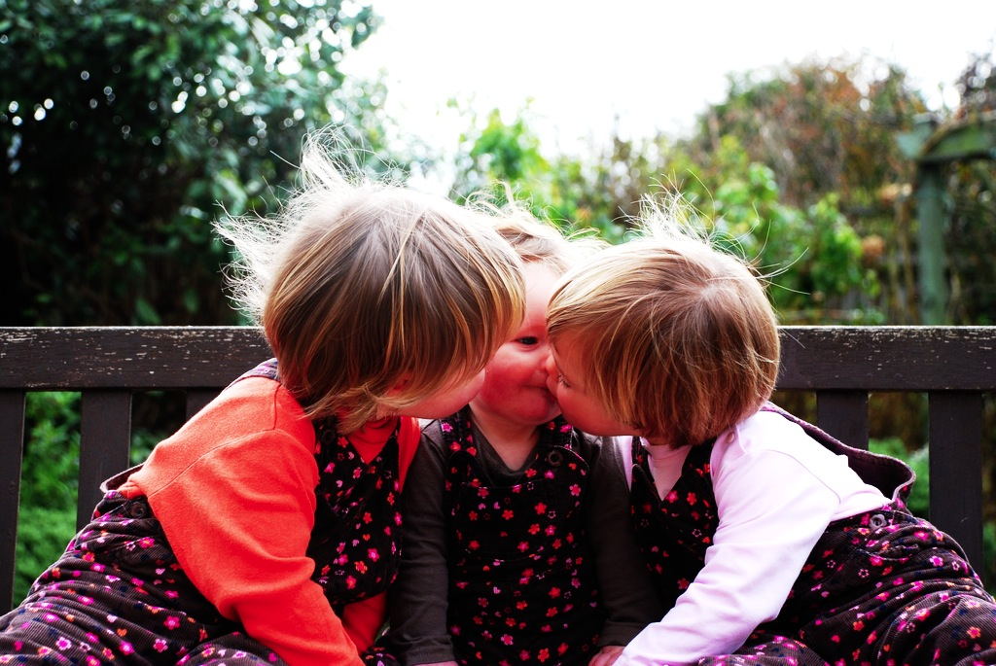
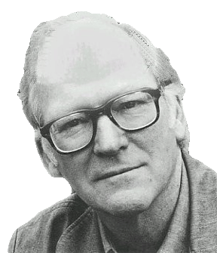
“We are stuck with our two main ways of describing and explaining things, one which treats objects and events as mindless, and the other which treats objects and events as having propositional attitudes. I see no way of bridging the gap by introducing an intermediate vocabulary.”
(Davidson 2003: 697)

Slide 123
“We are stuck with our two main ways of describing and explaining things, one which treats objects and events as mindless, and the other which treats objects and events as having propositional attitudes. I see no way of bridging the gap by introducing an intermediate vocabulary.”
(Davidson 2003: 697)

Slide 125

appendix
What could infants, chimps and scrub-jays represent that would enable them, within limits, to track others’ perceptions, knowledge, beliefs and other propositional attitudes?

Slide 126




Intentional relation
e.g. She is interested in that chocolate
e.g. She is smiling at me
Propositional attitude
e.g. She believes that the chocolate is in that cupboard

Slide 127

Your field = a set of objects related to you by proximity, orientation, lighting and other factors
You encounter an object = it is in your field
You register an object at a location = you most recently encountered the object at that location

Slide 128
Your field = a set of objects related to you by proximity, orientation, lighting and other factors
You encounter an object = it is in your field
You register an object at a location = you most recently encountered the object at that location
proximity
orientation
lighting
barriers
trajectory

Slide 129
Your field = a set of objects related to you by proximity, orientation, lighting and other factors
You encounter an object = it is in your field
You register an object at a location = you most recently encountered the object at that location
proximity
orientation
lighting
barriers
trajectory

Slide 130
Your field = a set of objects related to you by proximity, orientation, lighting and other factors
You encounter an object = it is in your field
You register an object at a location = you most recently encountered the object at that location
Principle 1: one can’t goal-directedly act on an object unless one has encountered it.
Principle 2: correct registration is a condition of successful action.
Principle 3: when an agent performs a goal-directed action and the goal specifies an object, the agent will act as if the object were actually in the location she registers it at.
proximity
orientation
lighting
barriers
trajectory

Slide 131
Your field = a set of objects related to you by proximity, orientation, lighting and other factors
You encounter an object = it is in your field
You register an object at a location = you most recently encountered the object at that location
Principle 1: one can’t goal-directedly act on an object unless one has encountered it.
Principle 2: correct registration is a condition of successful action.
Principle 3: when an agent performs a goal-directed action and the goal specifies an object, the agent will act as if the object were actually in the location she registers it at.
proximity
orientation
lighting
barriers
trajectory

Slide 132
Your field = a set of objects related to you by proximity, orientation, lighting and other factors
You encounter an object = it is in your field
You register an object at a location = you most recently encountered the object at that location
Principle 1: one can’t goal-directedly act on an object unless one has encountered it.
Principle 2: correct registration is a condition of successful action.
Principle 3: when an agent performs a goal-directed action and the goal specifies an object, the agent will act as if the object were actually in the location she registers it at.
proximity
orientation
lighting
barriers
trajectory

Slide 133
Your field = a set of objects related to you by proximity, orientation, lighting and other factors
You encounter an object = it is in your field
You register an object at a location = you most recently encountered the object at that location
Principle 1: one can’t goal-directedly act on an object unless one has encountered it.
Principle 2: correct registration is a condition of successful action.
Principle 3
proximity
orientation
lighting
barriers
trajectory

Slide 134
Your field = a set of objects related to you by proximity, orientation, lighting and other factors
You encounter an object = it is in your field
You register an object at a location = you most recently encountered the object at that location
Principle 1: one can’t goal-directedly act on an object unless one has encountered it.
Principle 2: correct registration is a condition of successful action.
Principle 3: when an agent performs a goal-directed action and the goal specifies an object, the agent will act as if the object were actually in the location she registers it at.
proximity
orientation
lighting
barriers
trajectory

Slide 135

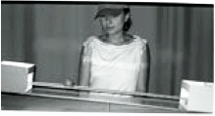
source Träuble, Marinovic, & Pauen (2010)

Slide 136
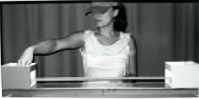
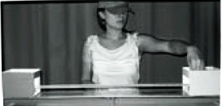
source Träuble, Marinovic, & Pauen (2010)

Slide 137
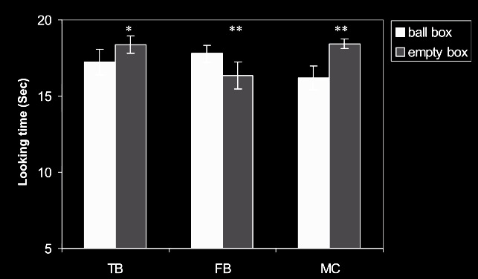
source Träuble, Marinovic, & Pauen (2010)

Slide 138
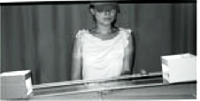
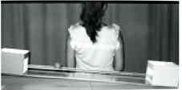
source Träuble, Marinovic, & Pauen (2010)

Slide 139
source Träuble, Marinovic, & Pauen (2010)

Slide 140

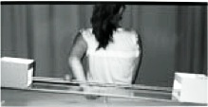
source Träuble, Marinovic, & Pauen (2010)

Slide 141
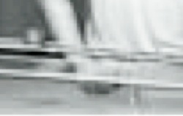
source Träuble, Marinovic, & Pauen (2010)

Slide 142
source Träuble, Marinovic, & Pauen (2010)

Slide 143
Your field = a set of objects related to you by proximity, orientation, lighting and other factors
You encounter an object = it is in your field
You register an object at a location = you most recently encountered the object at that location
Principle 1: one can’t goal-directedly act on an object unless one has encountered it.
Principle 2: correct registration is a condition of successful action.
Principle 3: when an agent performs a goal-directed action and the goal specifies an object, the agent will act as if the object were actually in the location she registers it at.
proximity
orientation
lighting
barriers
trajectory

Slide 144
Your field = a set of objects related to you by proximity, orientation, lighting and other factors
You encounter an object = it is in your field
You register an object at a location = you most recently encountered the object at that location
Principle 1: one can’t goal-directedly act on an object unless one has encountered it.
Principle 2: correct registration is a condition of successful action.
Principle 3: when an agent performs a goal-directed action and the goal specifies an object, the agent will act as if the object were actually in the location she registers it at.
proximity
orientation
lighting
barriers
trajectory

Slide 145
Principle 2: correct registration is a condition of successful action.
source Träuble, Marinovic, & Pauen (2010)

Slide 146
signature limits

Slide 147
1. Charly is Samantha
2. Mitch believes that Charly is in Baltimore
3. Mitch believes that Samantha is in Baltimore
(1) & (2) ⇒ (3)

Slide 148
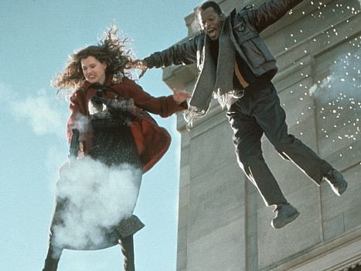
1. Charly is Samantha
2. Mitch believes that Charly is in Baltimore
3. Mitch believes that Samantha is in Baltimore
(1) & (2) ⇒ (3)

Slide 149
1. Charly is Samantha
2. Mitch believes that Charly is in Baltimore
3. Mitch believes that Samantha is in Baltimore
(1) & (2) ⇒ (3)
4. Mitch registers <Charly, Baltimore>
5. Mitch registers <Samantha, Baltimore>
(1) & (4) ⇒ (5)

Slide 150
False belief about location
False belief about identity
Subjects represent registration
Subjects represent beliefs
pass
fail
pass
pass

Slide 151
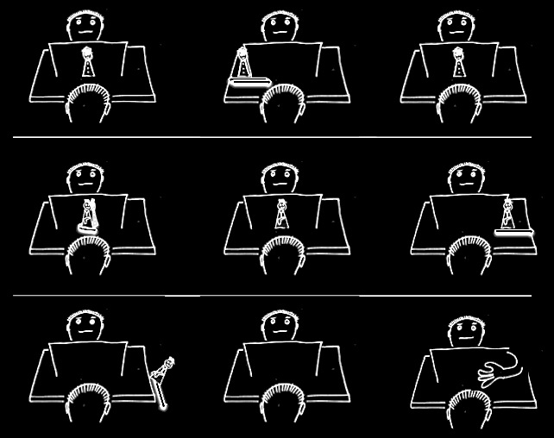

Slide 156
Which Joint Actions
Ground Social Cognition?
s.butterfill@warwick.ac.uk

Slide 157
Theory of mind abilities are widespread

Slide 158
Theory of mind abilities are widespread
18-month-olds point to inform, and predict actions based on false beliefs
(Liszkowski et al 2006)
(Onishi & Baillargeon 2005; Southgate et al 2007)

Slide 159
Theory of mind abilities are widespread
18-month-olds point to inform, and predict actions based on false beliefs
Scrub-jays selectively re-cache their food in ways that deprive competitors of knowledge of its location
(Liszkowski et al 2006)
(Onishi & Baillargeon 2005; Southgate et al 2007)
(Clayton, Dally & Emery 2007)

Slide 160
Theory of mind abilities are widespread
18-month-olds point to inform, and predict actions based on false beliefs
Scrub-jays selectively re-cache their food in ways that deprive competitors of knowledge of its location
Chimpanzees conceal their approach from a competitor’s view, and act in ways that are optimal given what another has seen
(Liszkowski et al 2006)
(Onishi & Baillargeon 2005; Southgate et al 2007)
(Clayton, Dally & Emery 2007)
(Hare, Call & Tomasello 2006)
(Hare, Call & Tomasello 2001)

Slide 161
Theory of mind abilities are widespread
18-month-olds point to inform, and predict actions based on false beliefs
Scrub-jays selectively re-cache their food in ways that deprive competitors of knowledge of its location
Chimpanzees conceal their approach from a competitor’s view, and act in ways that are optimal given what another has seen
(Liszkowski et al 2006)
(Onishi & Baillargeon 2005; Southgate et al 2007)
(Clayton, Dally & Emery 2007)
(Hare, Call & Tomasello 2006)
(Hare, Call & Tomasello 2001)

Slide 162
Theory of mind abilities are widespread
18-month-olds point to inform, and predict actions based on false beliefs
Scrub-jays selectively re-cache their food in ways that deprive competitors of knowledge of its location
Chimpanzees conceal their approach from a competitor’s view, and act in ways that are optimal given what another has seen
(Liszkowski et al 2006)
(Onishi & Baillargeon 2005; Southgate et al 2007)
(Clayton, Dally & Emery 2007)
(Hare, Call & Tomasello 2006)
(Hare, Call & Tomasello 2001)

Slide 163
Theory of mind abilities are widespread
18-month-olds point to inform, and predict actions based on false beliefs
Scrub-jays selectively re-cache their food in ways that deprive competitors of knowledge of its location
Chimpanzees conceal their approach from a competitor’s view, and act in ways that are optimal given what another has seen
(Liszkowski et al 2006)
(Onishi & Baillargeon 2005; Southgate et al 2007)
What doinfants, chimps and scrub-jays represent that enables them, within limits, to track others’ perceptions, knowledge, beliefs and other propositional attitudes?
(Clayton, Dally & Emery 2007)
(Hare, Call & Tomasello 2006)
(Hare, Call & Tomasello 2001)

Slide 164
Theory of mind abilities are widespread
18-month-olds point to inform, and predict actions based on false beliefs
Scrub-jays selectively re-cache their food in ways that deprive competitors of knowledge of its location
Chimpanzees conceal their approach from a competitor’s view, and act in ways that are optimal given what another has seen
Representing perceptions, knowledge states and beliefs is hard

Slide 165
Theory of mind abilities are widespread
18-month-olds point to inform, and predict actions based on false beliefs
Scrub-jays selectively re-cache their food in ways that deprive competitors of knowledge of its location
Chimpanzees conceal their approach from a competitor’s view, and act in ways that are optimal given what another has seen
Representing perceptions, knowledge states and beliefs is hard, for it requires
(a) conceptual sophistication
- takes years to develop
- development tied to acquisition of executive function and language
- development facilitated by training and siblings

Slide 166
Theory of mind abilities are widespread
18-month-olds point to inform, and predict actions based on false beliefs
Scrub-jays selectively re-cache their food in ways that deprive competitors of knowledge of its location
Chimpanzees conceal their approach from a competitor’s view, and act in ways that are optimal given what another has seen
Representing perceptions, knowledge states and beliefs is hard, for it requires
(a) conceptual sophistication
- takes years to develop
- development tied to acquisition of executive function and language
- development facilitated by training and siblings
(b) scarce cognitive resources
- attention
- working memory

Slide 167
Theory of mind abilities are widespread
18-month-olds point to inform, and predict actions based on false beliefs
Scrub-jays selectively re-cache their food in ways that deprive competitors of knowledge of its location
Chimpanzees conceal their approach from a competitor’s view, and act in ways that are optimal given what another has seen
Representing perceptions, knowledge states and beliefs is hard, for it requires
(a) conceptual sophistication
- takes years to develop
- development tied to acquisition of executive function and language
- development facilitated by training and siblings
(b) scarce cognitive resources
- attention
- working memory

